Slide 1
The Innovative Pro Assistant
Butrind Zekaj & Oliver Richani

Slide 2
Project goal
Ease access of internal documents/specifications for employee’s work by
Providing summaries
Accessing specific parts of documentation
Simplify scheduling meetings by
Creating meetings agendas based on employees’s availability
Stackholders
End Users
Project managers
IT department such as IT Administrators, UI/UX Designers, developpers, etc..
Operations management
Investors
Marketing department
Secretaries, Advertisment
Project method
Hermes V
Agile practice
Scrum

Slide 3
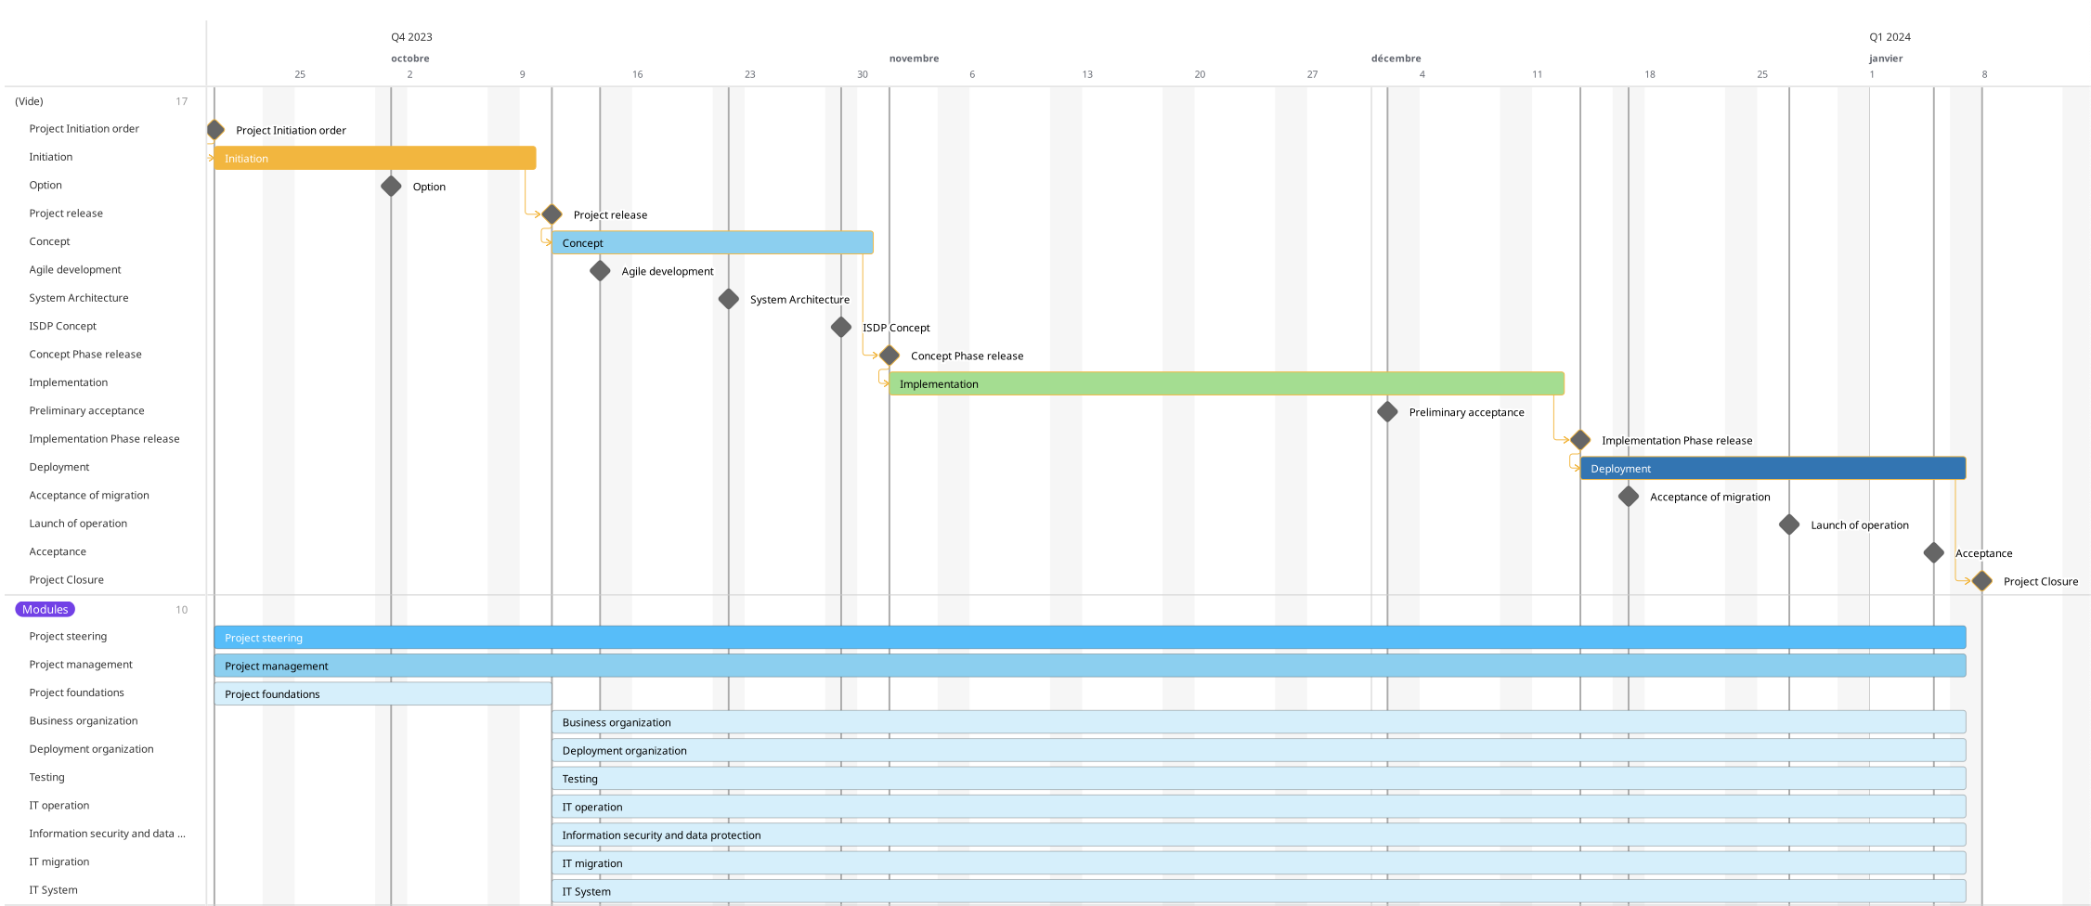
Project plan

Slide 4
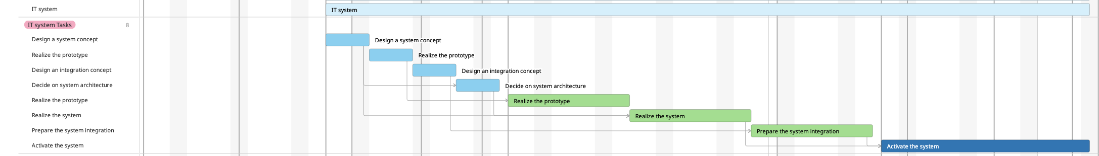
IT System Module

Slide 5
Challenges
Organizational
Technological
Communication issues between employees
Lack of training or skills
Poor risk analysis
Modification of objectives during the process
Delays due to missmanagement of deadlines
Cost related to stakeholders’s withdrawal
Skills below expectations
Ensuring AI Assistant is properly integrated into all departments
Lack of security concerning company information
Can’t handle efficiently enough number of queries
Can’t deal with all the data of the company
Not user-friendly enough
Cost of various systems too high (i.e. licensed software, subscriptions)
AI Assistant provide incorrect or irrelevant answers
Lack of regular updates of the system
AI Assistant should be usable even during updates, maintenances, etc...

Slide 6

THANK YOU
Butrind Zekaj & Oliver Richani

